Slide 1
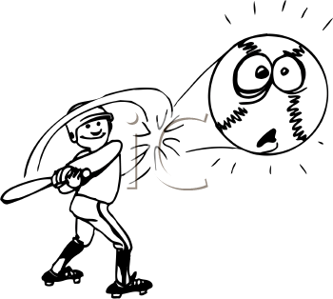
Maru Batting Center (Part II)

Slide 2
Elite Ballplayer Segment
Men and Women age between 16 to 35
Amateur players or semi-pro leagues sponsored by local corporations
Focused on best equipments and quality service
Price charged by MBC | ¥ 7500
Retention Rate | 60%
Acquisition Cost | ¥ 50,000
Interest Rate | 0.1

Slide 3
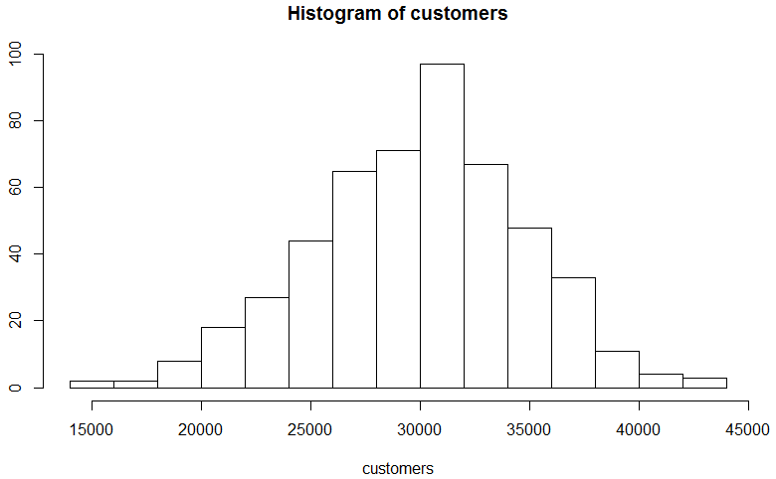
Distribution for Annual Margin
summary statistics:
min: 14812.93 max: 43184.56
Median: 30204.06
Mean: 29949.88
Estimated sd: 4798.066
Estimated skewness: -0.1656298
Estimated kurtosis: 3.0311
Observation:
Slightly Left Skewed
Notes:
we used R functions to identify what kinda distribution it is. fitdistrplus.
Kurtosis is a measure of whether the data are peaked or flat relative to a normal distribution. That is, data sets with high kurtosis tend to have a distinct peak near the mean, decline rather rapidly, and have heavy tails.

Slide 4
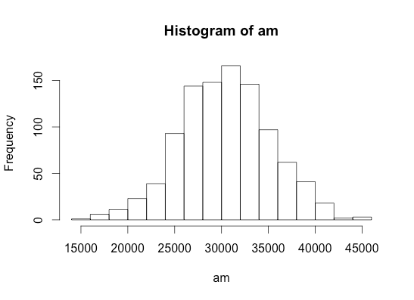
Simulation for Annual Margin
library(sn)
am<-rsn(n=1000, xi=29949.88, omega=4798.066, alpha=--0.1656298 , tau=0, dp=NULL)
#xi:mean, omega:sd,alpha:skew
Notes:
Then we used same statistic to generate the annual margin distribution for 1000 customers.
rsn: random number generation for skewed normal distribution

Slide 5
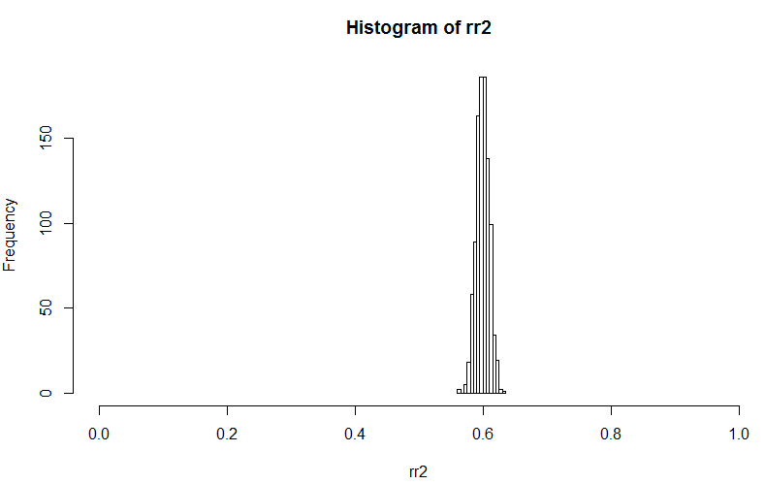
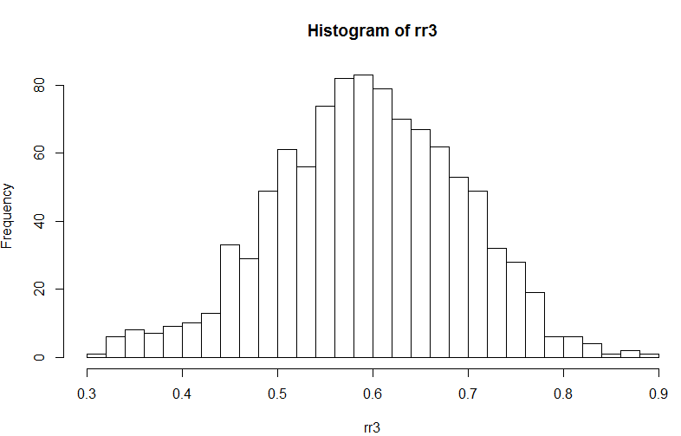
Distribution for Retention Rate
RR - Normal Distribution with high σ
rnorm(100000,0.6,0.1)
RR - Normal Distribution with low σ
rnorm(100000,0.6,0.01)

Slide 6
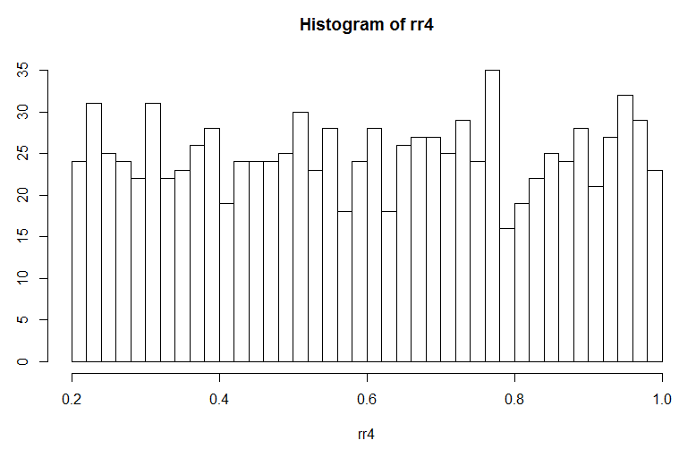
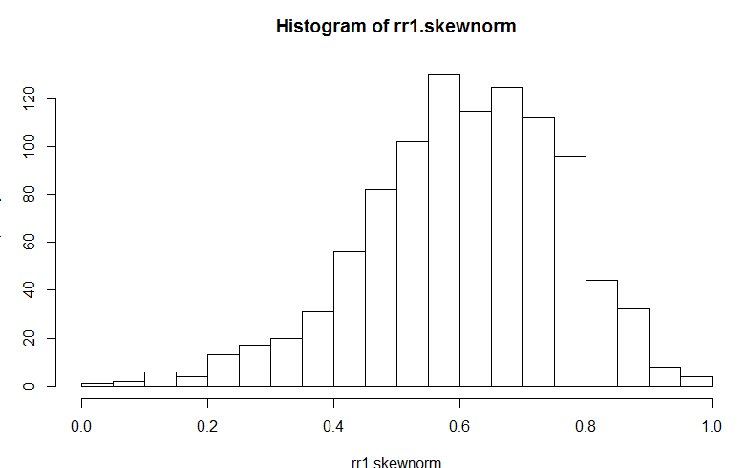

RR - Left Skewed Distribution
rr1 <- rsn(n=100000, xi=0, omega=1, alpha=-2, tau=0, dp=NULL)
min.rr1 = min(rr1)
max.rr1 = max(rr1)
rr1.skewnorm = (rr1 - min.rr1)/(max.rr1 - min.rr1)
rr1.mean = ( mean (rr1) - min.rr1)/(max.rr1 - min.rr1)
RR - Uniform Distribution
runif(100000, min = 0.2, max = 1)

Slide 7
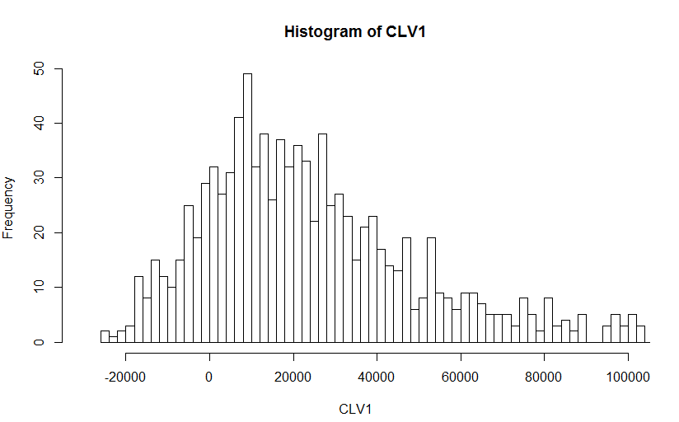
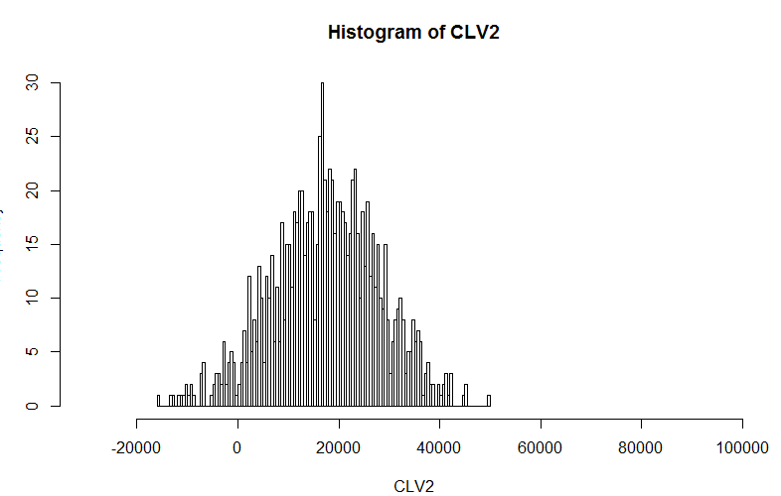
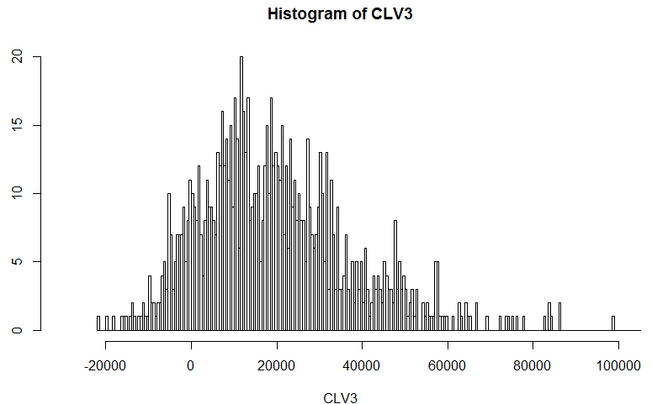
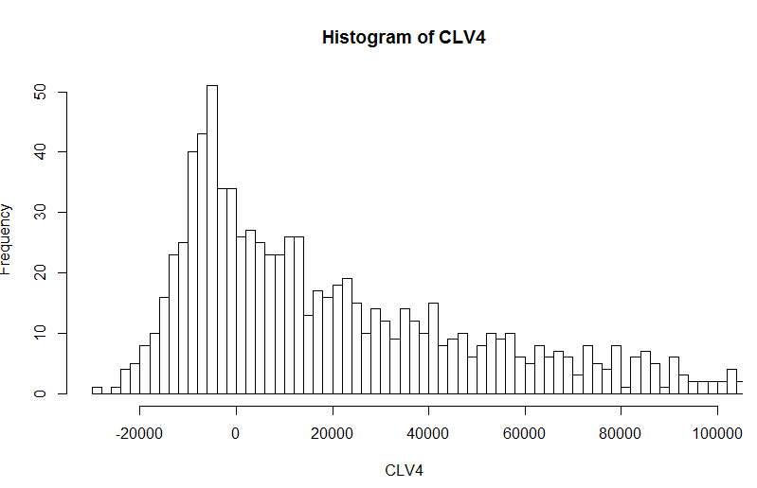
CLV simulation, sample=1000

Slide 8
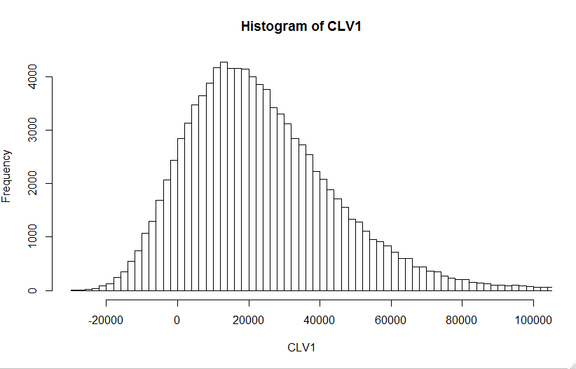
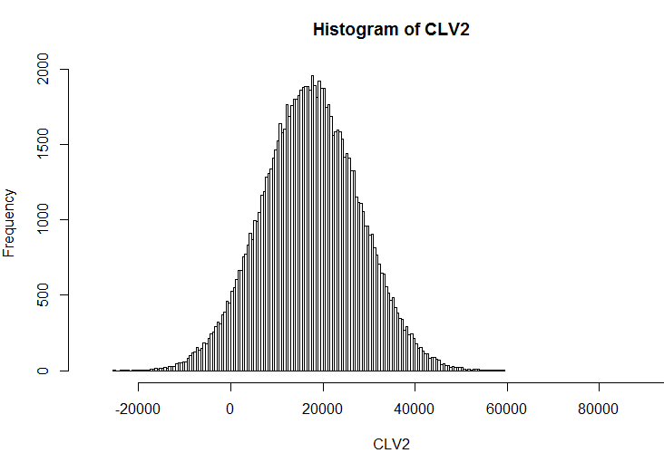

Slide 9
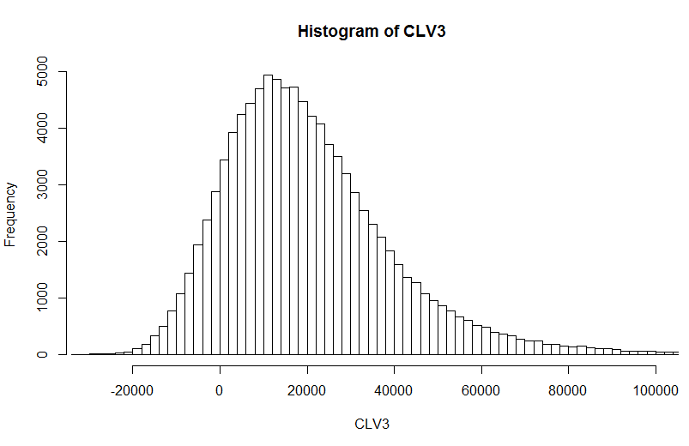
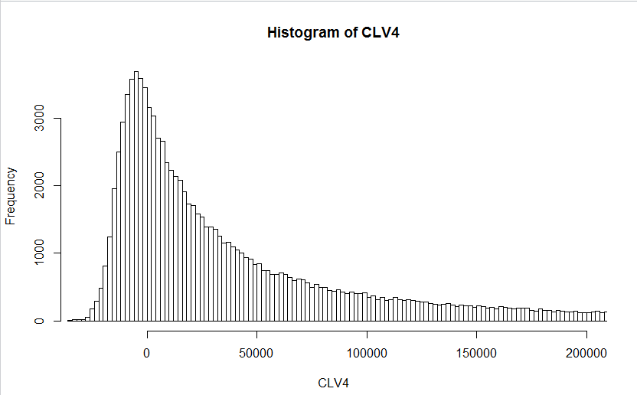

Slide 10
Value Concentration for CLV
Step 1: Calculate aggregate CLV－total CLV
Step 2: Sort CLVs and start adding from high to low
Step 3: Stop when the sum is higher than the 50% of total CLV
Step 4: Find out % of customers
R Logic
Results:
Left skewed distribution: 18.94 %
Normal Distribution with low σ: 28.45 %
Normal Distribution with high σ: 20.06 %
Uniform Distribution: 10.765 %

Slide 11
Comparison to Aggregate Level Analysis
CLV from case 1 : ¥16000
Distribution of Annual Margin:
Distribution of Annual Margin does not affect Average CLV
Only the mean of Annual Margin effects the average CLV
Average CLV by RR Distribution:
Left skewed distribution: ¥ 23927.46
Normal Distribution with low σ: ¥ 17537.7
Normal Distribution with high σ: ¥ 20649.97
Uniform Distribution: ¥ 42725.5

Slide 12
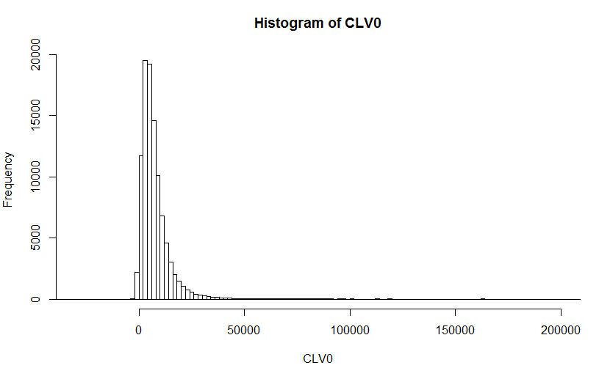

CLV-Elite Ballplayer
CLV - Little Leaguers
Notes:
We used the same simulation process for the Little leaguer, to compare and analyze the most important segment to Maru
We used left skewed distribution for both retention rates and for elite ballplayers margin i.e. 0.6 and 0.75
but we used direct margin number 5000 from case 1 for Little leaguers.
We even calculated the value concentration for both, Elite Ballplayer concentration rate:18.94 %, little leaguers is 18.57%, but they both are quite similar % (i.e. top 18% customers contributing to most of the aggragate CLV) of due to same distribution used.
Thus, considering the average CLV values, we say Elite Ballplayer are more important.

Slide 13

Final Recommendation
To improve the simulation and get precise estimate of CLV,
MBC needs:
Retention rate for individual customer
Data from more # customers
Risk and uncertainty
How??
Notes:
Yearly retention rate of Customers
To track the external conditions (like macroeconomic conditions,) which account to the risk
discounting cash flow from each customer would be beneficial
Even though we did simulation, it would be really helpful if we did sensitivity analysis to account for risk and uncertainity
Although we have seen the distribution , and the distribution considers the risk sensitivity

Slide 14
Thank You!
Q&A

